Slide 1
Strengthening Community Councils
Exploring how community councils can contribute to democratic renewal in Scotland.
Andrew Paterson and Paul Nelis, SCDC
Oliver Escobar, What Works Scotland
April 2019

Slide 2
Purpose of the Event
To reflect on the research finding and to discuss them with colleagues here today from community councils, civic society, public sector, academia etc.
To think about how we’ll use the recommendations and research in the future.
Photos
Twitter #StrengtheningCCs and #CelebrateCCs
Introductions

Slide 3
the big picture: a global democratic recession?
Notes:
Globally:
Democracy Index, down
Authoritarian values amongst young people, up

Slide 4
Democratic Recession
The last 10 years there have seen a reduction in the number of democratic systems, and established democracies are under increasing pressure due to social, political, environmental and economic factors (Wike & Fetterolf, 2018)
The Economist Intelligence Unit's Democracy Index 2016 >>
global average score fell with 72 countries dropping in the ranking compared to 2015, and just 38 moving up
number of “full democracies” dropped from 20 to 19 (USA now classed as “flawed”)
around half the world's population (49.3%) live in a democracy of some kind. But only 4.5% of people live in a “full democracy” - half as many as in 2015
Democratic principles enjoy broad support, but current practices and institutions provoke cynicism > people love the idea of democracy, but despair at how it is practiced
Global Attitudes Survey shows increased indifference, frustration and authoritarian attitudes particularly in the youngest populations of democratic systems around the world (Foa & Mounk, 2016)

Slide 5
Participation in local decision-making in Scotland: deficits and aspirations (Scottish Social Attitudes Survey 2015 + Ipsos Mori 2014)
35% of Scottish citizens said they feel part of how decisions affecting their community are made
96% said that people should be involved in making decisions about how local services are planned and run
80% said that people should be involved in deciding how money is spent on local services
77% said would get more involved in their community if it was easier to participate in decisions that affect it

Slide 6
Policy and research context for public participation and democratic innovation
Local Governance Review (> Local Democracy Bill?)
Places, people and planning – Position Statement 2017
Re-launch of the National Standards for Community Engagement (2016)
Community Empowerment (Scotland) Act 2015
Participatory Budgeting national programme (2014-2019)
COSLA Commission on Strengthening Local Democracy (2014)
Parliamentary Local Government Committee (2013, 2014)
National Planning Framework 3
Christie Commission on Future Delivery of Public Services 2011
Community Councils Short-Life Working Group (2011)
Audits and reviews of Community Planning (2011, 2012, 2013, 2016, 2018)

Slide 7
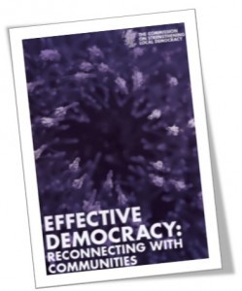
2014 COSLA Commission on Strengthening Local Democracy
“50 years of centralisation has not tackled the biggest problems that Scotland faces
For a country with Scotland’s wealth and strength, the level of inequality is intolerable, and has huge social and financial costs
There is a link between the absence of strong local democracy and the prevalence of inequalities
It is communities that empower governments at all levels, not governments that empower people”

Slide 8
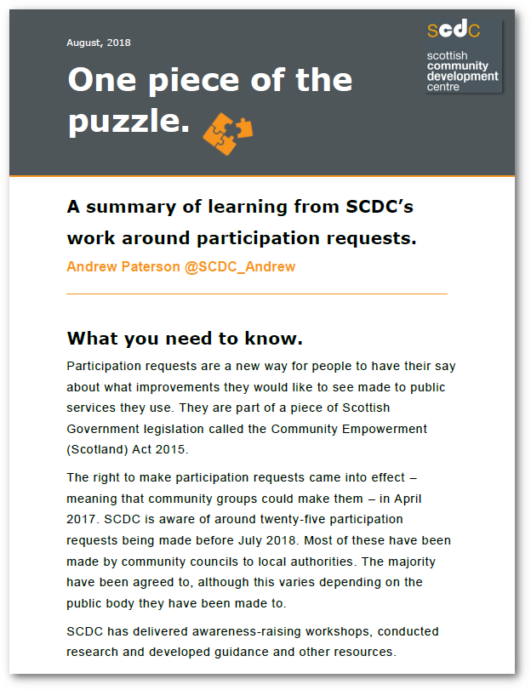
Background to our research
Community empowerment
Democratic renewal
Building on what’s there

Slide 9
Methods
Self-funded research by What Works Scotland and Scottish Community Development Centre
Research Reference group (RRG)
Literature review
5 regional workshops
Online survey with 600+ responses
(mainly community councillors)

Slide 10
Findings - Participation
CCs are involved in a myriad of aspects of community life
Challenges around recruitment, competitive elections and diversity
Calls for better promotion
Relationship with other community organisations

Slide 11
Example – Dennistoun CC
Engagement with the wider community, as well as other community councils, housing associations, the Local Area Partnership and other third sector organisations and professional structures.
“Dennistoun Community Council has established strong relationships with our community. Councillors attend meetings out in the community such as those held by Associate Members and other community groups which builds a good network of community relationships.” (Member of DCC)

Slide 12
Findings - Power and influence
Which powers?
Stronger representation in decision making structures
Being consulted earlier in the planning system
Spending powers
Role of elected members
Oversight and accountability

Slide 13
Example – Money for Moray
The Joint Community Councils of Moray (JCC) set up, then helped to run, the community-led participatory budgeting (PB) initiative, Money for Moray.
The project has organised five voting events that have enabled people in Moray to decide how to allocate £275,000 of funding to local projects
M4M say this has “generated more interest in the work of Community Councils and has increased membership in some”. Also “helps the credibility of Community Councils with agencies”

Slide 14
Findings - Support
Information
Training and capacity building in a range of areas
Resources
Association

Slide 15
Example – Midlothian’s Federation of CCs
Consists of representatives from the 16 community councils in Midlothian.
Meets to address issues of shared concern.
Provides a collective voice when engaging with agencies.
Has representatives on community planning groups to ensure information is shared and community councils have a voice in local decision-making structures.

Slide 16
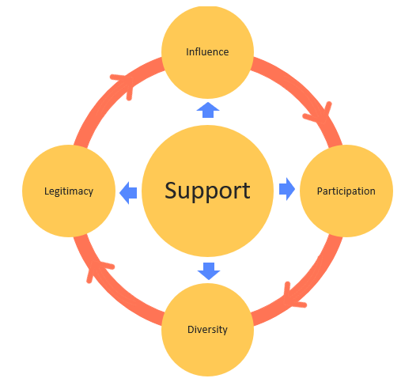

Slide 17
Key recommendations
The Local Governance Review should consider strengthening CCs to improve local democracy.
CCs should be given more power and resources at same time as supported to better represent local diversity.
Required support includes training, capacity building, CC associations and compensation schemes to address barriers to participation.
Options for making CC membership more representative of local diversity should be considered.
The Scottish Government should conduct a publicity campaign around CCs
Reforms should be flexible and take account of local need.

Slide 18
Discussion Panel
Angus Hardie (Leith Links Community Council and Scottish Community Alliance)
Lauren Bennie (Dennistoun Community Council)
Hayley Bennet (University of Edinburgh)
Facilitated by Oliver Escobar (University of Edinburgh, What Works Scotland)

Slide 19
Reactions/reflections
What do you make of the findings from this review of CCs?
Take 20 minutes to discuss and please agree on two points to be shared in plenary

Slide 20
Keynote listeners
Nick Bland (Scottish Government)
Lynn Sharp (Improvement Service)
Kristoffer Boesen (Improvement Service)
Lorraine Gillies (Scottish Community Safety Network)
Evelyn O’Donnell (Glasgow City Council)
Hayley Barnett (COSLA)

Slide 21
What should happen next?
Discuss for 20 minutes
Possible considerations….
What are the opportunities within context of democratic renewal (e.g. Local Governance Review)
What can we do to take the recommendations forward?
What else can be done?

Slide 22
Thank you
Contact:
Andrew Paterson, SCDC, andrew@scdc.org.uk
Paul Nelis, SCDC, paul@scdc.org.uk
Oliver Escobar, Oliver.Escobar@ed.ac.uk
Remember to tweet #StrengtheningCCs and #CelebratingCCs
Event held in partnership with the Scottish Government and the Improvement Service.

